Slide 1
CHAPTER - IX DATA STRUCTURES LINEAR LISTS

Slide 2
INTRODUCTION

Slide 3
INTRODUCTION
What is Data Structure?
In computer science, a data structure is a particular way of organizing data in a computer so that it can be used
Data structures provide a means to manage large amounts of data efficiently for uses such as large databases and internet indexing services. Usually, efficient data structures are key to designing efficient algorithms.

Slide 4
DATA STRUCTURE OPERATIONS
Data are processed by means of certain operations which appearing in the data structure. Following are the most common types of Data structure operations.
1. TRAVERSING
2. SEARCHING
3. INSERTING
4. DELETING
5. SORTING
6. MERGING

Slide 5
DATA STRUCTURE OPERATIONS
1. TRAVERSING
Accessing each records exactly once so that certain items in the record may be processed.
2. SEARCHING
Finding the location of a particular record with a given key value, or finding the location of all records which satisfy one or more conditions.

Slide 6
DATA STRUCTURE OPERATIONS
3. INSERTING
Adding a new record to the structure.
4. DELETING
Removing the record from the structure.

Slide 7
DATA STRUCTURE OPERATIONS
5. SORTING
Managing the data or record in some logical order(Ascending or descending order).
6. MERGING
Combining the record in two different sorted files into a single sorted file.

Slide 8
ELEMENTRAY DATA REPRESENTATION

Slide 9
ELEMENTRAY DATA REPRESENTATION
Data can be in two forms:
1. RAW DATA
2. DATA ITEM

Slide 10
1. RAW DATA
These are facts. In simplest form these are values.
2. DATA ITEM
These represent single unit of values of certain type.

Slide 11
DATA TYPE VS DATA STRUCTURES

Slide 12
DATA TYPE VS DATA STRUCTURES
DATA TYPE refers to the type i.e integer or float or character or string for the data which is represented in the memory location of the computer system.
DATA STRUCTURE refers to the physical implementation or arrangement of data in the memory I other words it defines a way of storing, accessing,manipulating od data stored in the data structure.

Slide 13
DIFFERENT DATA STRUCTURES
Data structures are broadly classified in to two types.
1. SIMPLE DATA STRUCTURE
2. COMPOUND DATA STRUCTURE

Slide 14
1. SIMPLE DATA STRUCTURE

Slide 15
1. SIMPLE DATA STRUCTURE
Simple Data structures are also called as primitive data structures and are built from basic data types viz int, float, boolean, characters are called simple data structures.
int
float
boolean
characters
…etc
ARRAY OR LINEAR LISTS

Slide 16
ARRAY or LINEAR LISTS
A linear array is a list of finite numbers of elements stored in the memory. In a linear array, we can store only homogeneous data elements. Elements of the array form a sequence or linear list that can have the same type of data. Each element of the array is referred by an index set.
Note: Arrays can be implemented through LIST or through NumPy arrays.

Slide 17
2. COMPOUND DATA STRUCTURE

Slide 18
2. COMPOUND DATA STRUCTURE
Compound Data Structure are complex in nature and are classified in to two types
1. LINEAR DATA STRUCTURES
2. NON LINEAR DATA STRUCTURES

Slide 19
1. LINEAR DATASTRUCTURES

Slide 20
1. LINEAR DATASTRUCTURES
What is Linear Data Structure?
A data structure is said to be linear data structure if its elements form a sequence.
meaning sequential arrangement of data is the linear data structure. For Example
LINEAR DATASTRUCTURES
i) STACK
ii) QUEUE
iii) LINKED LISTS

Slide 21
NON LINEAR DATASTRUCTURES

Slide 22
2. NON LINEAR DATASTRUCTURES
What is Non Linear Data Structure?
A non-linear data structure is a data structure in which a data item is connected to several other data items. So that a given data item has the possibility to reach one-or-more data items.
NON LINEAR DATASTRUCTURES
TREES

Slide 23
DATASTRUCTURES
SIMPLE DATA
STRUCTURES
COMPOUND DATA
STRUCTURES
ARRAYS
LINEAR
NON LINEAR
TREES
i) STACK
ii) QUEUE
iii) LINKED LISTS

Slide 24
STACKS

Slide 25
STACKS
What is STACK?
In computer science, a stack is a last in, first out (LIFO) data structure. A stack is characterized by only two fundamental operations and they are:
The PUSH operation adds an item to the top of the stack.
The POP operation removes an item from the top of the stack.
1. PUSH
2. POP

Slide 26
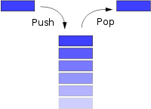
STACKS

Slide 27
QUEUE

Slide 28
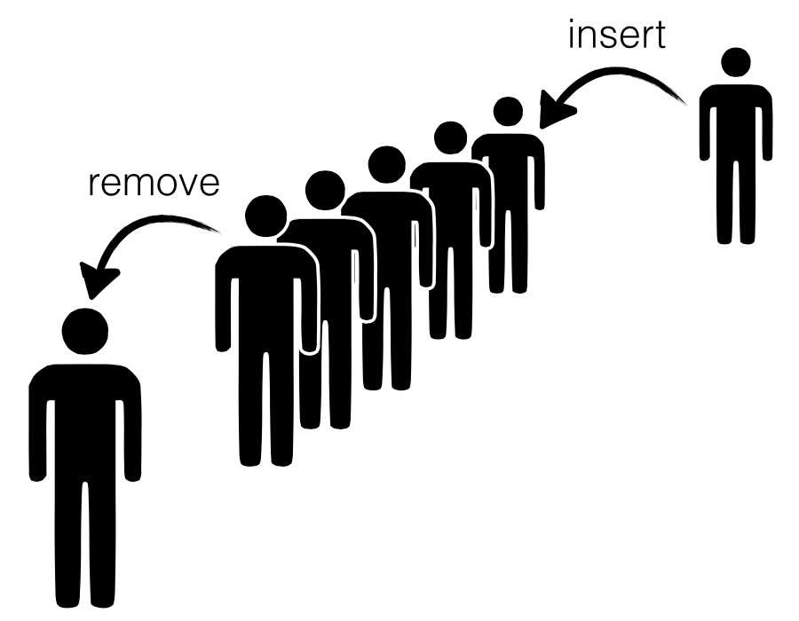
QUEUE
What is Queue?
Queue is a linear data structure which follows First In First Out (FIFO) rule in which a new item is added at the rear end and deletion of item is from the front end of the queue. In a FIFO data structure, the first element added to the queue will be the first one to be removed.

Slide 29
LINKED LISTS

Slide 30
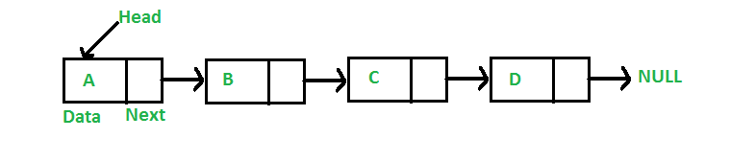
LINKED LISTS
What is Linked List?
A linked list is a linear data structure, in which the elements are not stored at contiguous memory locations. The elements in a linked list are linked using pointers as shown in the below image:

Slide 31
TREES

Slide 32
TREES
What is Tree?
Tree is a non-linear data structure which organizes data in a hierarchical structure and this is a recursive definition.
OR
A tree is a connected graph without any circuits.
OR
If in a graph, there is one and only one path between every pair of vertices, then graph is called as a tree.

Slide 33
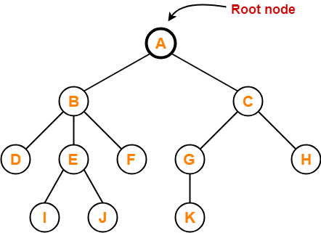
TREES

Slide 34
SEARCHING

Slide 35
SEARCHING
What is Searching?
Searching is an operation or a technique that helps finds the place of a given element or value in the list.
There are various algorithms , most common searching algorithms are:-
1. LENEAR SEARCH OR SEQUENTIAL SEARCH
2. BINARY SEARCH

Slide 36
1. LINEAR SEARCH OR SEQUENTIAL SEARCH

Slide 37

1. LINEAR SEARCH OR SEQUENTIAL SEARCH
What is Linear Search or Sequential Search?
In computer science, a linear search or sequential search is a method for finding an element within a list. It sequentially checks each element of the list until a match is found or the whole list has been searched.

Slide 38
1. LINEAR SEARCH OR SEQUENTIAL SEARCH
WAPP to search an element in a given list using Linear Search Method using NumPy
import numpy as np
def Linear_Search():
L1=[9,32,67,72,899,390,879]
a=np.array(L1)
Search_Val=int(input("Enter the Searching Element"))
found=0
pos=1

Slide 39
1. LINEAR SEARCH OR SEQUENTIAL SEARCH
WAPP to search an element in a given list using Linear Search Method using NumPy
for i in a:
if i==Search_Val:
found=1
break
pos= pos+1
if found:
print("Element is found at location ",pos)
else:
print("Element is not found!")
Linear_Search()

Slide 40
1. LINEAR SEARCH OR SEQUENTIAL SEARCH
WAPP to search an element in a given list using Linear Search Method
def Sequential_Search(dlist, item):
pos = 0 found = False
while pos < len(dlist) and not found:
if dlist[pos] == item:
found = True
else: pos = pos + 1
return found, pos

Slide 41
1. LINEAR SEARCH OR SEQUENTIAL SEARCH
Linear Search or Sequential Search Analysis
ITEM PRESENT:
Best Case : 1
Average Case : ½
Worst Case : n
ITME NOT PRESENT:
Best Case : n
Average Case : n
Worst Case : n

Slide 42
2. BINARY SEARCH

Slide 43
2. BINARY SEARCH
What is Binary Search?
In computer science, binary search, also known as half-interval search, logarithmic search, or binary chop, is a search algorithm that finds the position of a target value within a sorted array.
Binary Search. Binary search is a fast search algorithm with run-time complexity of Ο(log n). This search algorithm works on the principle of divide and conquer. For this algorithm to work properly, the data collection should be in the sorted form.

Slide 44
2. BINARY SEARCH
def binary_search(alist, key):
start = 0
end = len(alist)
while start < end:
mid = (start + end)//2
if alist[mid] > key:
end = mid
elif alist[mid] < key:
start = mid + 1
else:
return mid
return -1

Slide 45
2. BINARY SEARCH
alist = input('Enter the sorted list of numbers: ')
alist = alist.split()
alist = [int(x) for x in alist]
key = int(input('The number to search for: '))
index = binary_search(alist, key)
if index < 0:
print('{} was not found.'.format(key))
else:
print('{} was found at index {}.'.format(key, index))

Slide 46
2. BINARY SEARCH
alist = input('Enter the sorted list of numbers: ')
alist = alist.split()
alist = [int(x) for x in alist]
key = int(input('The number to search for: '))
index = binary_search(alist, key)
if index < 0:
print('{} was not found.'.format(key))
else:
print('{} was found at index {}.'.format(key, index))

Slide 47
INSERTION IN LINEAR LIST

Slide 48
INSERTION IN LINEAR LIST
Insertion of new element in array can be done in two ways:-
If the array is unordered it can be inserted at the end of array.
If the array is sorted then new element is added at appropriate position without altering the order of the list or array.

Slide 49
INSERTION IN LINEAR LIST
# Function to insert element
def insert(list, n):
# Searching for the position
for i in range(len(list)):
if list[i] > n:
index = i
break

Slide 50
INSERTION IN LINEAR LIST
# Inserting n in the list
list = list[:i] + [n] + list[i:]
return list
# Driver function
list = [1, 2, 4]
n = 3
print(insert(list, n))

Slide 51
INSERTING AN ELEMENT IN SORTED ARRAY

Slide 52
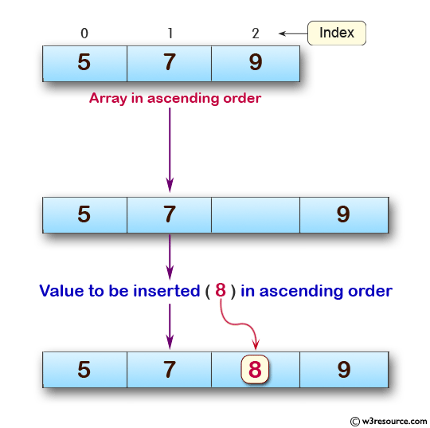
INSERTING AN ELEMENT IN SORTED ARRAY
Inserting new element in sorted list requires the searching the right position and shifting the elements. As shown in fig.

Slide 53
bisect MODULE

Slide 54
bisect MODULE
Inserting new element in sorted list requires the searching the right position and shifting the elements. This is the complex procedure.
Python provides bisect algorithm to solve this problem

Slide 55
bisect MODULE
What is bisect?
Python in its definition provides the bisect algorithms using the module “bisect” which allows to keep the list in sorted order after insertion of each element.

Slide 56
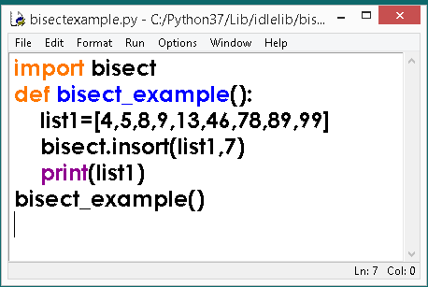
bisect MODULE

Slide 57
bisect MODULE
To know the position of element in the given list execute the following method.
bisect.bisect(list,element)
For example: bisect.bisect(list1,46)
6

Slide 58
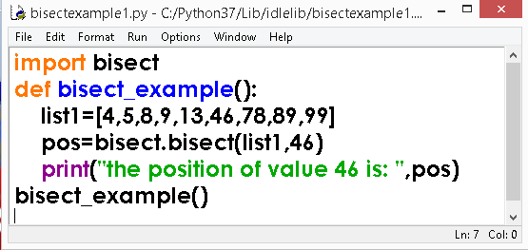
bisect MODULE

Slide 59
bisect MODULE

Slide 60
Delete an element from an array

Slide 61
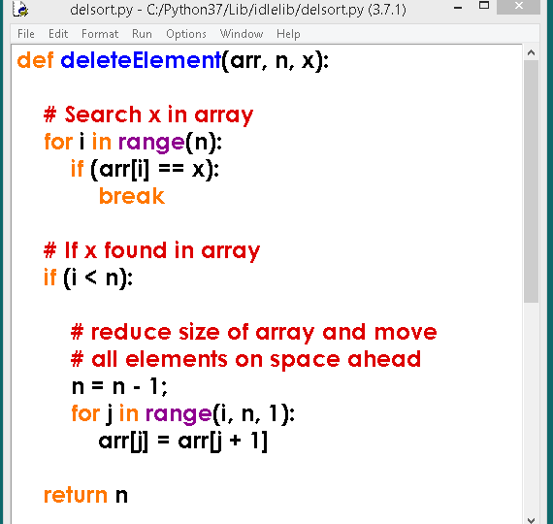
Delete an element from an array

Slide 62
LIST COMPREHENSIONS (LC)

Slide 63
LIST COMPREHENSIONS (LC)
What is List Comprehensions (LC)?
List comprehension is an elegant way to define and create list in python.
We can create lists just like mathematical statements and in one line only. The syntax of list comprehension is easier to grasp.

Slide 64
LIST COMPREHENSIONS
The list comprehension starts with a '[' and ']', to help you remember that the result is going to be a list..
Syntax:
List1=[ expression for item in list if conditional ]
For example:
list2=[i for i in range(0,5)]
print (list2)

Slide 65
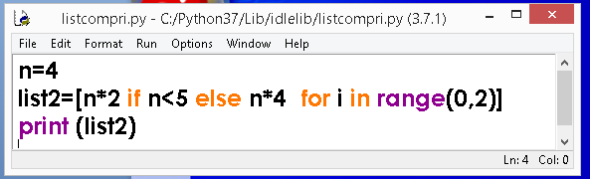
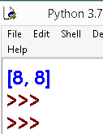
LIST COMPREHENSIONS - Examples
OUTPUT
Understanding the Code:
If n is less than 5 generate 2 values i.e n x 2 as per the for loop else generate 2 values i.e n x 4, the out put will be:- 8 8

Slide 66
LIST COMPREHENSIONS - Examples
Create a list called points
Using for loop
Using List comprehension
Ans: i)
Points=[]
for i in range (0,5):
Points.append(i)
Ans ii)
Points=[i for i in range (0,5)]

Slide 67
LIST COMPREHENSIONS - Examples
Create a list called vals which stores square of numbers
Ans:
vals=[i*2 for i in range (0,5)]

Slide 68
LIST COMPREHENSIONS - Examples
Given an input list scores, produce a list namely scores2, using list comprehension having numbers from scores that are multiples of 4.
Scores=[23,4,12,16,18,9]
Ans:
Scores2=[num for num in scores if num%4==0]

Slide 69
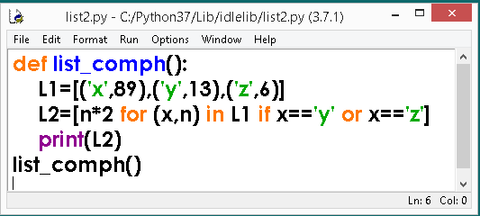
LIST COMPREHENSIONS - Examples
Consider the following code and write the output.

Slide 70
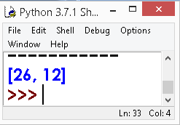
LIST COMPREHENSIONS - Examples
Consider the following code and write the output.
OUTPUT

Slide 71
LIST COMPREHENSIONS - Advantages

Slide 72
LIST COMPREHENSIONS - Advantages
01
CODE REDUCTION
FASTER CODE EXECUTION
02
03
READABLE
04
LESS ERROR PRONE
PYTHONIC
05
INTENT IS CLEAR
06

Slide 73
LIST COMPREHENSIONS - Advantages
1. CODE REDUCTION
A code of multiple statements gets reduced to single line of code.
2. FASTER CODE EXECUTION
LC are executed faster than loops and other equivalent statements.

Slide 74
LIST COMPREHENSIONS - Advantages
2. FASTER CODE EXECUTION
There are two reasons for faster execution:
Python will allocate memory first before adding elements to it.
Calls append() function get avoided, reducing function overhead time.

Slide 75
LIST COMPREHENSIONS - Advantages
3. READABLE
It is more readable (when you get used to it).
4. LESS ERROR PRONE
Once you are familiar with LC, there is less chance to error prone.

Slide 76
LIST COMPREHENSIONS - Advantages
3. READABLE
It is more readable (when you get used to it).
4. LESS ERROR PRONE
Once you are familiar with LC, there is less chance to error prone.

Slide 77
LIST COMPREHENSIONS - Advantages
5. PYTHONIC
LC are more PYTHONIC as they truly represent the python code, hence generate interest among developers to write concise and accurate code.

Slide 78
LIST COMPREHENSIONS - Advantages
6. INTENT IS CLEAR
Intent is clear: to initialise a list. A loop could be doing anything, you have to read it to check that it doesn’t have any other side effects. A list comprehension just sets up the list, you know it isn’t up to anything else.

Slide 79
NESTED LISTS or TWO DIMENSIONAL LISTS

Slide 80
NESTED LISTS or TWO DIMENSIONAL LISTS
A list is a container which holds comma-separated values (items or elements) between square brackets where items or elements need not all have the same type.
A nested list is a list that appears as an element in another list. In this list.

Slide 81
NESTED LISTS or TWO DIMENSIONAL LISTS
nums = [[1, 2], [3, 4], [5, 6]]
print(nums[0])
print(nums[1])
print(nums[2])
print(nums[0][0])
print(nums[0][1])
print(nums[1][0])
print(nums[2][1])

Slide 82
Creating 2D List

Slide 83
Creating 2D List
L1=[]
r=int(input(“How many rows?”))
c=int(input(“How many Columns?”))
for i in range(r):
row = []
for j in range( c):
ele=int(input(“element”, i , “ , ” , j ))
row.append(ele)
L1.append(row)
print(“List is “ ,L1)

Slide 84
TRAVERSING 2D LIST
print(“List is “ ,L1)
for i in range(r):
print(“\t[“,end=“ “)
for j in range( c):
print(L1[i][j], end=“ “)
print(“]”)
print(“\t ] “ )

Slide 85
REPRESENTATION OF 2D LIST IN MEMORY

Slide 86
REPRESENTATION OF 2D LIST IN MEMORY
TwoDLst= [ [ 8 , 7 , 6 ] , [ 4 , 3 , 2 ] ]
TwoDLst
id1
id2
id3
id1
0
0
8
7
6
0
4
3
2
1
1
1
2
2

Slide 87
REPRESENTATION OF 2D LIST IN MEMORY
What is Regular 2D List?
If row size and column size are same then it is said to be Regular 2D List.
What is Ragged List?
If row size and column size are not same then it is said to be Ragged List.

Slide 88
SLICES IN 2D LISTS
TwoDLst= [ [ 8 , 7 , 6 ] , [ 4 , 3 , 2 ] , [ 7 ,3 , 1 ] ]
>>>TwoDLst[:1]
[ [ 8 , 7 , 6 ] , [ 4 , 3 , 2 ]]
>>> TwoDLst[1:]
[[ 4 , 3 , 2 ] , [ 7 ,3 , 1 ] ]

Slide 89
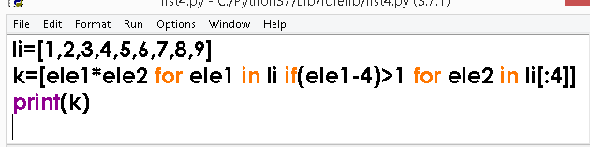
FIND THE OUTPUT

Slide 90
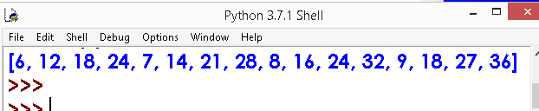
FIND THE OUTPUT
OUTPUT

Slide 91
Thank You

